Slide 1
5 Testing Myths Revealed
Why do we need tests?
Bonny Hinners Salesforce MVP

Slide 2
Apex unit tests are all I need.
Myth #1

Slide 3
Wait, there’s more!
White Box Testing
Unit tests
Black Box Testing
End to end functional test
Grey Box Testing
End to end with knowledge of the system

Slide 4
Order of Execution
On the server, Salesforce:Loads the original record from the database or initializes the record for an upsert statement.
Loads the new record field values from the request and overwrites the old values.If the request came from a standard UI edit page, Salesforce runs system validation to check the record for:Compliance with layout-specific rules
Required values at the layout level and field-definition level
Valid field formats
Maximum field length
When the request comes from other sources, such as an Apex application or a SOAP API call, Salesforce validates only the foreign keys. Before executing a trigger, Salesforce verifies that any custom foreign keys do not refer to the object itself.Salesforce runs user-defined validation rules if multiline items were created, such as quote line items and opportunity line items.
Executes all before triggers.
Runs most system validation steps again, such as verifying that all required fields have a non-null value, and runs any user-defined validation rules. The only system validation that Salesforce doesn't run a second time (when the request comes from a standard UI edit page) is the enforcement of layout-specific rules.
Executes duplicate rules. If the duplicate rule identifies the record as a duplicate and uses the block action, the record is not saved and no further steps, such as after triggers and workflow rules, are taken.
Saves the record to the database, but doesn't commit yet.
Executes all after triggers.
Executes assignment rules.
Executes auto-response rules.
Executes workflow rules.
If there are workflow field updates, updates the record again.
If the record was updated with workflow field updates, fires before update triggers and after update triggers one more time (and only one more time), in addition to standard validations. Custom validation rules, duplicate rules, and escalation rules are not run again.The refiring of triggers isn't limited to updates, but applies to all operation types. A workflow field update that fires on record insert will rerun any before and after insert triggers again—as insert triggers.
Executes processes and flows launched via processes and flow trigger workflow actions.When a process or flow executes a DML operation, the affected record goes through the save procedure.
Executes escalation rules.
Executes entitlement rules.
If the record contains a roll-up summary field or is part of a cross-object workflow, performs calculations and updates the roll-up summary field in the parent record. Parent record goes through save procedure.
If the parent record is updated, and a grandparent record contains a roll-up summary field or is part of a cross-object workflow, performs calculations and updates the roll-up summary field in the grandparent record. Grandparent record goes through save procedure.
Executes Criteria Based Sharing evaluation.
Commits all DML operations to the database.
Executes post-commit logic, such as sending email.

Slide 5
Automations
Apex Triggers and Classes
Validation Rules
Workflow Rules/ Approval Processes
Process Builder Actions / Visual Flow

Slide 6
Nobody rechecks tests in production after deployments.
Myth #2

Slide 7
Apex Test Execution
Measure org health
More tests should pass in the future than are passing today

Slide 8
Salesforce does all the testing I need for each of their releases.
Myth #3

Slide 9
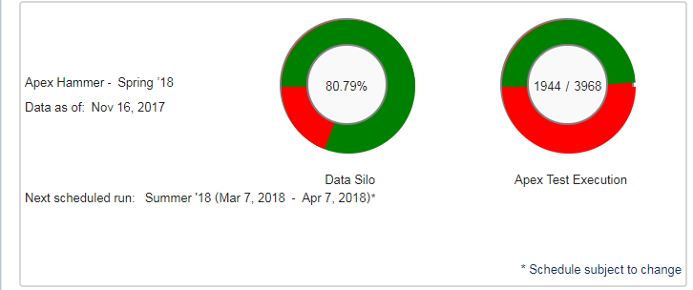
Hammer Test is Selective
Feature Focus
Pre-release Sandbox is for all your testing

Slide 10
Data security is not related to testing.
Myth #4

Slide 11
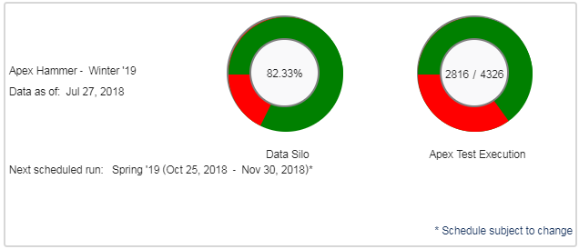
Salesforce Trust
Data Silo

Slide 12
Nobody tests configuration, just code.
Myth #5

Slide 13
Flow and Process Builder Tests
New with Winter ‘19
https://snugsfbay.github.io/df18/

